Slide 1



ATTITUDES MATTER: EXPLORING CLINICIAN PERSPECTIVES ON THE FUTURE OF AI IN PSYCHOLOGICAL SERVICES
Sam Pye
Trainee Clinical Psychologist, University of Surrey
s.pye@surrey.ac.uk

Slide 2
Psychology, AI and why attitudes matter
Technology acceptance
Thesis research (in progress)

Slide 3
PSYCHOLOGY, TECHNOLOGY AND AI
“I’m not good at tech!”
Psychology professionals as late adopters of new technology
Psychology has traditionally been seen as a uniquely human field — but Generative AI is starting to challenge that idea
Notes:
"I'm not good at tech" is something I often hear from psychologists and psychology professionals.
Psychologists typically tend to be late adopters of new technologies.
Research going back to 1996 found that in a sample of psychologists, over half rated themselves as mildly/ majorly technophobic.
Psychologists are rarely technologists, potentially due to the human/ person centred ethos at the heart of psychology.
Beliefs about the impact of technology on the therapeutic relationship.
Psychology has traditionally been seen as a uniquely human field empathy, sensitivity— but Generative AI is starting to challenge that idea
Gen AI challenges the idea that psychological care requires human interpretation, emotional attunement, or professional intuition. For some, it raises existential questions: If an AI can perform these tasks with accuracy and empathy, what is left that only a human clinician can do?

Slide 4
WHY SHOULD WE CARE ABOUT ATTITUDES?
New technologies are routinely developed and implemented without the involvement of key stakeholders.
Historically, clinician acceptance has acted as a key barrier to technology adoption in healthcare
Understanding the specific barriers to adoption is vital to the effective development and implementation of AI tools.
Notes:
It is no secret that technology is unfortunately, routinely developed and Implemented (or attempted to be implemented) without the involvement of key stakeholders.
Story about how psychologist who consulted on the development of an AI mental health app that was being developed by 12 coders and no clinicians.
Historically clinician acceptance has been cited as a key barrier to the adoption of digital technology. The best example of this is telemental health where, even though video call therapy was deemed to be acceptable in terms of efficacy, safety, and even patient acceptance it was still not adopted. Clinicians were skeptical about it's effectiveness and even believed that patients wouldn't find it helpful (even when they did!). It took a global pandemic to show us all the benefits. The risk is that the story will be the same for the integration of AI.
There is also a lack of in depth research exploring stakeholder perspectives of emerging AI technology.
Therefore it is vital to understand the specific barriers to adoption of generative AI tools in order to ensure that they are developed and implemented safely and effectively.

Slide 5
TECHNOLOGY ACCEPTANCE
Theoretical

Slide 6
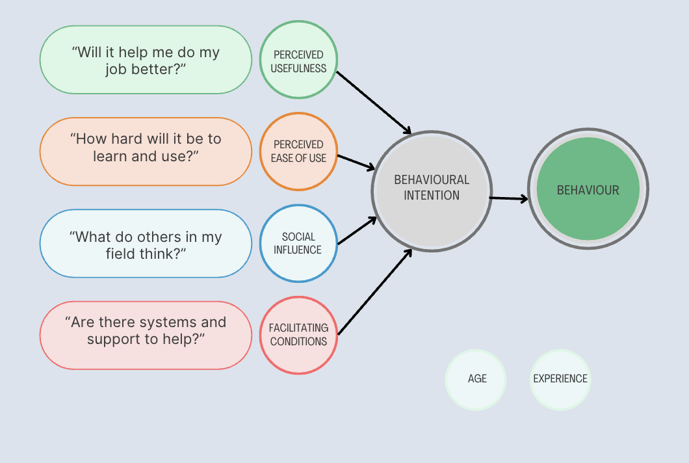
TAM - Davis, F. D. (1989).
UTAUT - Venkatesh, V., Morris, M. G., Davis, G. B., & Davis, F. D. (2003).
Notes:
Unified theory of usage and acceptance of technology.
Little research looking at these factors in relation to psychology professionals and AI. Nor about the relative importance of each of these factors in predicting the adoption of new technologies.
Important to see how vital these factors are in predicting usage.
Moderators are also really important: age, experience, professional factors (profession, years of clinical experience)
How this might play out:
Lower perceived ease of use
Older individuals often perceive technology as harder to use, which strongly impacts their behavioral intention to adopt it.
Less Exposure, Less Confidence
Without regular interaction with tech, they may feel less confident, contributing to low perceived usefulness
Weaker Facilitating Conditions
They may lack access to training, peer support, or tailored tools that ease adoption.
Social Influence Might Backfire
If peers are also skeptical or unfamiliar with the technology, positive peer pressure may be absent.

Slide 7
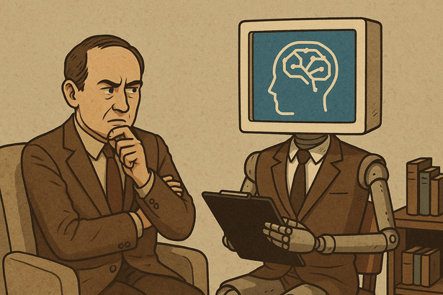
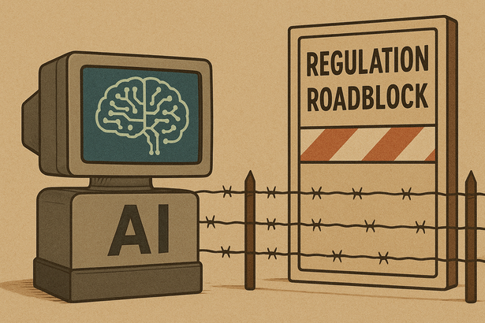
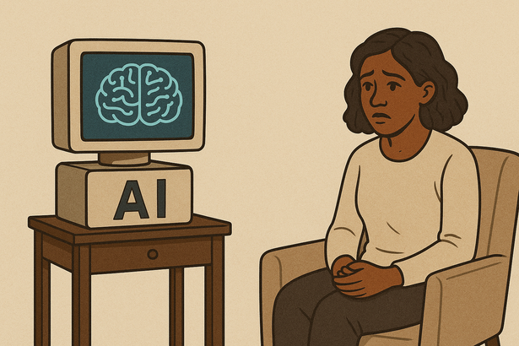
OTHER SPECIFC FACTORS?!
?
?
?
?
Notes:
Lack of integration into clinical workflows
Trust
Threat to professional identity
Regulatory concerns
Confidentiality concerns
Safety concerns
Model bias
Model blackboxxing
Environmental concerns

Slide 8
RESEARCH RATIONALE
Theoretical
STUDY 1 - SHORT SURVEY
STUDY 2 - INTERVIEW STUDY
Notes:
The motivation for this research stems from the accelerating development of generative AI and its potential to transform psychological services. Despite this potential, adoption across the psychology profession is inconsistent (or completely unknown!), and little is known about what drives or hinders uptake.
This study is designed to fill that gap by identifying the key predictors of intention to adopt emerging generative AI tools clinically. It draws on models like the Technology Acceptance Model.
By understanding these factors, we can not only support developers in creating tools that align with clinical values, but also inform training, regulation, and organisational strategies that make AI adoption both acceptable and effective. Ultimately, this research contributes to safe, ethical, and person-centred implementation of AI in mental healthcare.

Slide 9
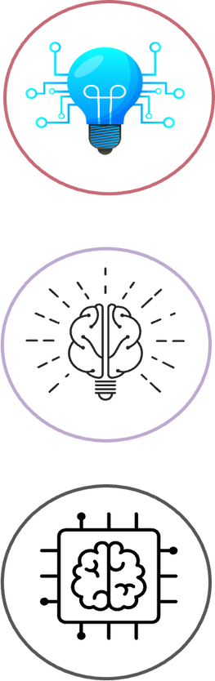
STUDY 1 - SHORT SURVEY
Current usage of generative AI
Factors predicting adoption intentions
Moderators of relationships

Slide 10

STUDY 2 - INTERVIEW STUDY
Interview to share their experiences and discuss the barriers and facilitators for adopting it as a tool for psychological formulation
Psychologist/ therapists given the opportuity of using Chat GPT as a psychological formulation assistant
Notes:
I am also interested in the specific use cases for generative AI within psychological services.
Again it is important that we understand how we can develop these tools in a way that is both safe for clients, and helpful for clinicians.
Psychological formulation - Introduction
A formulation is a joint effort between you and
the psychologist to summarise your difficulties, to
explain why they may be happening and to make
sense of them. It may include past difficulties and
experiences if these are relevant to the present.
It acknowledges your strengths and resources. It
also helps the psychologist work out what needs to
be done in order for you to feel better and recover.
There is quite a bit of evidence that developing this
kind of account of your problems can be helpful.
Often a formulation is used alongside a diagnosis
given by a medical doctor, but sometimes it is used
instead of a diagnosis.
Emerging research has begun to explore the feasibility of using ChatGPT as a tool for psychodynamic formulations and psychological counselling, with promising results. Research by Hwang et al. (2024) and demonstrated that ChatGPT can generate psychodynamic formulations and case conceptualizations that are rated as appropriate, accurate, and feasible by experts. These findings are further supported anecdotally by case studies (Raile, 2024).

Slide 11
IMPLICATIONS
Enables targeted development of AI tools that meet professional needs
Ensures tools are acceptable and useful in real-world practice
Identifies barriers that hinder adoption and strategies to overcome them as well as facilitators that can be leveraged to promote use
Supports smoother integration into clinical workflows
Identify key training and educational needs
Notes:
Understanding the predictors, barriers, and facilitators of AI adoption is critical for both the development and successful implementation of AI tools in clinical practice. From a development perspective, knowing what professionals value—such as ease of use, clinical relevance, or transparency—allows developers to design tools that align with real-world needs and avoid features that generate resistance.
On the adoption side, examining these factors reveals what might prevent uptake, such as concerns around professional identity, lack of training, or ethical worries. At the same time, it identifies what helps—such as clear benefits, peer endorsement, or existing familiarity.
Together, this knowledge bridges the gap between innovation and implementation, ensuring that AI tools are not just technically sound, but also widely accepted and used. This is especially important in psychology, where professional culture, trust, and perceived usefulness strongly shape practice.

Slide 12
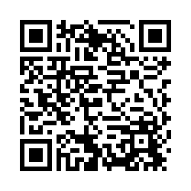
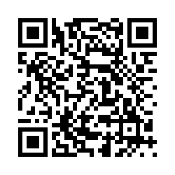
I WOULD LOVE TO HEAR FROM YOU!
Study 1 (survey study)
Study 2 (Interview study)
s.pye@surrey.ac.uk

Slide 13


THANK YOU
s.pye@surrey.ac.uk

Slide 14
REFERENCES
Davis, F. D. (1989). Perceived usefulness, perceived ease of use, and user acceptance of information technology. MIS quarterly, 319-340.
Rosen, L. D., & Weil, M. M. (1996). Psychologists and technology: A look at the future. Professional Psychology: Research and Practice, 27(6), 635.
Pulakos, E. D., Arad, S., Donovan, M. A., & Plamondon, K. E. (2000). Adaptability in the workplace: development of a taxonomy of adaptive performance. Journal of applied psychology, 85(4), 612.
Rogers, E. M. (2003). Diffusion of innovations (5th ed.). Free Press.
Venkatesh, V., Morris, M. G., Davis, G. B., & Davis, F. D. (2003). User acceptance of information technology: Toward a unified view. MIS Quarterly, 27(3), 425-478.
van der Ham, I. J., van der Vaart, R., Miedema, A., Visser-Meily, J. M., & van der Kuil, M. N. (2020). Healthcare professionals’ acceptance of digital cognitive rehabilitation. Frontiers in psychology, 11, 617886.
Whitten, P. S., & Mackert, M. S. (2005). Addressing telehealth's foremost barrier: provider as initial gatekeeper. International journal of technology assessment in health care, 21(4), 517-521.
Cowan, K. E., McKean, A. J., Gentry, M. T., & Hilty, D. M. (2019, December). Barriers to use of telepsychiatry: clinicians as gatekeepers. In Mayo Clinic Proceedings (Vol. 94, No. 12, pp. 2510-2523). Elsevier.
Li, B., Chen, Y., Liu, L., & Zheng, B. (2023). Users’ intention to adopt artificial intelligence-based chatbot: a meta-analysis. The Service Industries Journal, 43(15-16), 1117-1139.
Morley, J., Floridi, L., Kinsey, L., & Elhalal, A. (2020). From what to how: an initial review of publicly available AI ethics tools, methods and research to translate principles into practices. Science and engineering ethics, 26(4), 2141-2168.
Morrison, K. (2021). Artificial intelligence and the NHS: a qualitative exploration of the factors influencing adoption. Future Healthcare Journal, 8(3), e648-e654.
Raile, P. (2024). The usefulness of ChatGPT for psychotherapists and patients. Humanities and Social Sciences Communications, 11(1), 1-8.

