Slide 1
Pablo Smithson Mental Health & Wellbeing Practitioner

Slide 2
Digital Clinical Safety: boring but important…
Acceptable Use Policy
Only 3 pages – key points:
Not for use in clinical scenarios - diagnoses etc
Careful with confidential data - but Copilot can only access the files you have permission to see
Be aware during meetings with sensitive topics
Human judgement is still king and Copilot may be biased
Appropriate use
Make sure to review outputs
Use labels when Copilot has been used, or inform participants
Data
Not shared with Microsoft, but is stored by Copilot to improve performance

Slide 3
March 2025: Copilot pilot
Our Trust (~350 licences): full NHS Connect pilot (~12k)
Online mini courses plus ‘drop-in cafés’
Digital staff responsive & supportive
Information Governance staff support in grey areas
Incentives line up nicely:
Encouragement to share use cases allows monitoring
More use cases means more colleagues have licenses
Open to proof-of-concepts

Slide 4
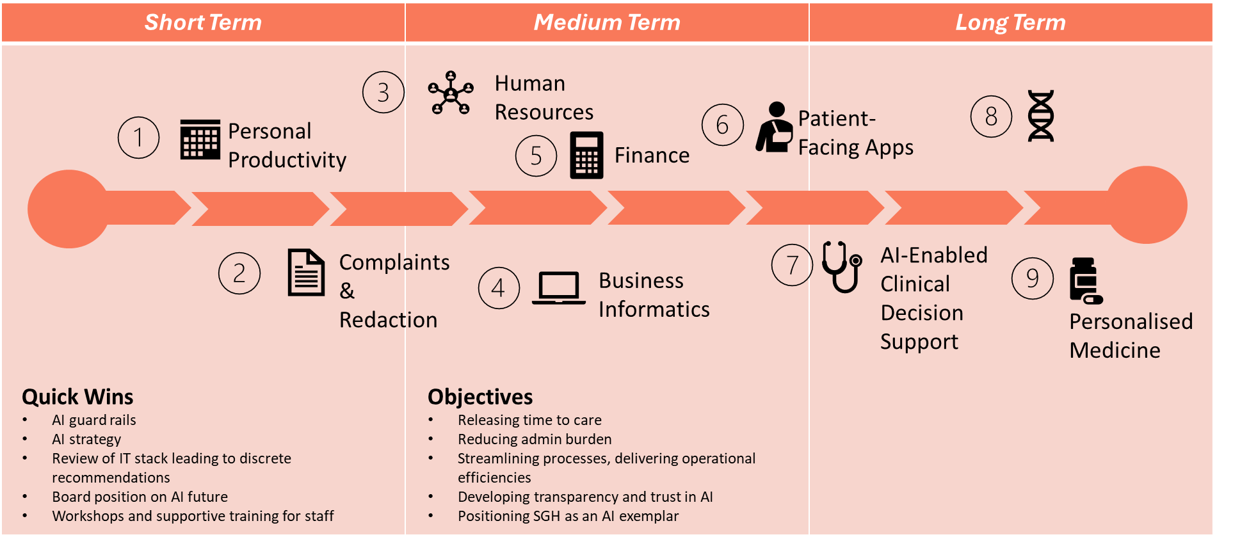
SPFT Vision for AI

Slide 5
The basics?
Meetings: recording, summarising, actions, ask questions during the meeting, follow up email to attendees
Transform documents from one format to another (Word to Powerpoint)
Summarise complex documents or videos
Rephrase text to make more accessible (e.g. for international readers)
Find emails, meetings or documents in your email account or Onedrive by describing them
Analyse data – describe what you want to do

Slide 6
Future possibilities…
Translating documents - different languages; different personas?
Meeting scheduling - currently difficult but shouldn’t be(!)
Transforming data - eg. for recording data or comment across different systems more quickly
Tell Copilot to ask you about your day, then suggest tools to make it more efficient
Task-specific Agents - specify resources and add guiding principles…

Slide 7
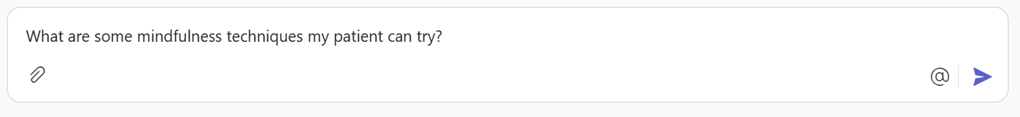
Agent-style task 1
Using Copilot to speed up preparation for Mental Health & Wellbeing Practitioner (low intensity, psychologically informed) appointments

Slide 8
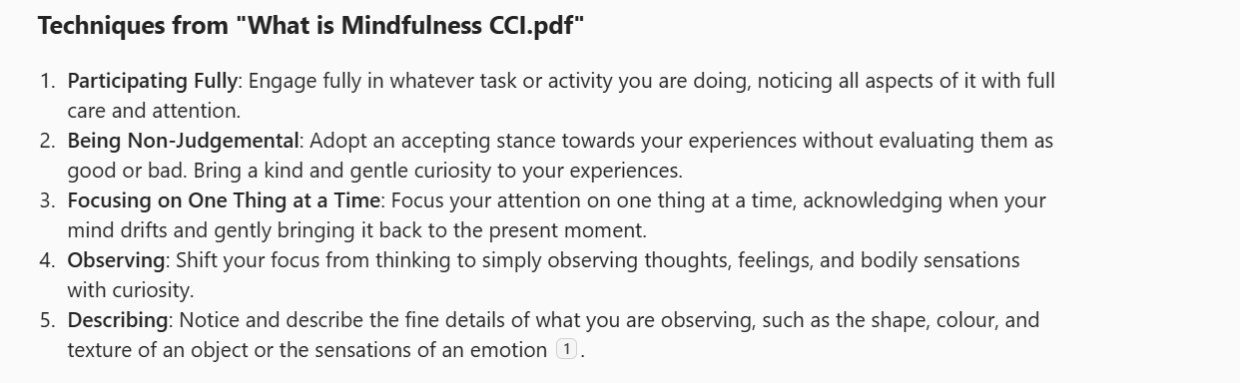
Agent-style task 2
Copilot can draw from particular trusted files

Slide 9
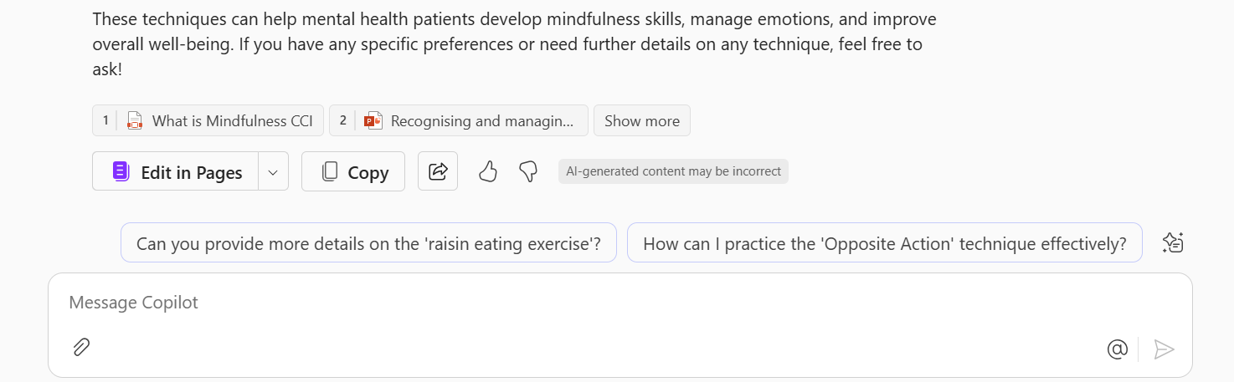
Agent-style task 3
It can also prompt you to explore them further – and answer the questions it suggests

Slide 10

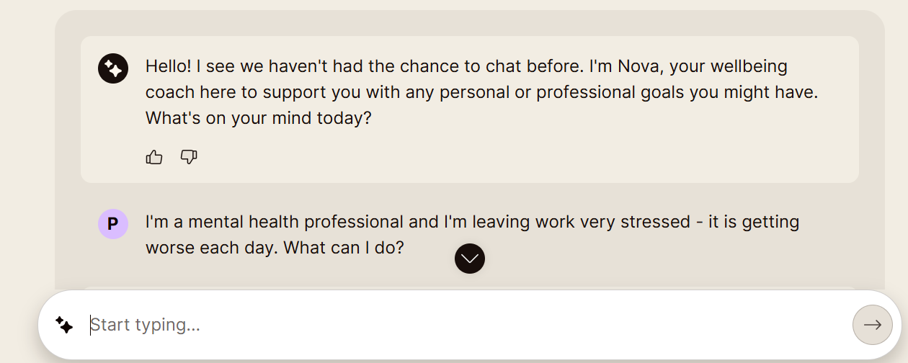
Unmind
SPFT staff have access to Unmind – not an SPFT product
Unmind’s comprehensive mental health platform combines therapy, coaching, AI, and expert insights
Impressive in the context of low-intensity interventions, but not a replacement for mental health professional

Slide 11
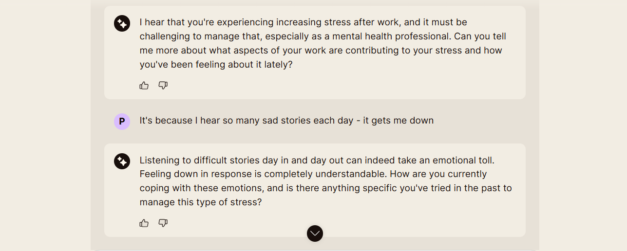
Sample conversation - 1

Slide 12
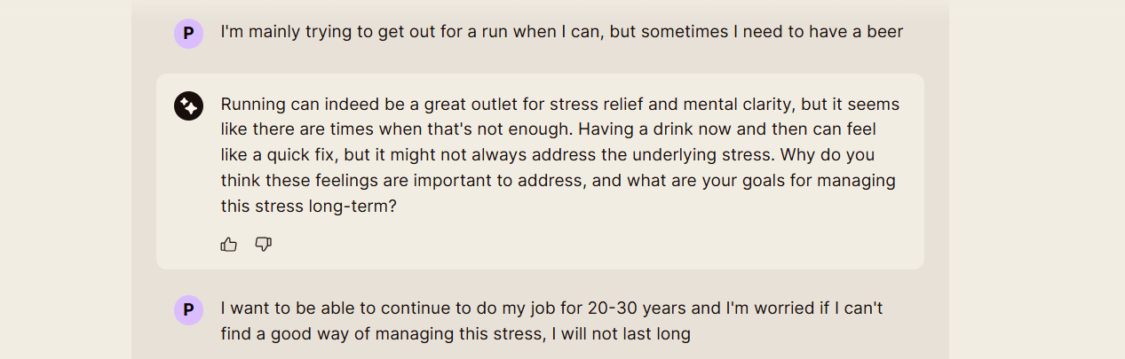
Sample conversation - 2

Slide 13
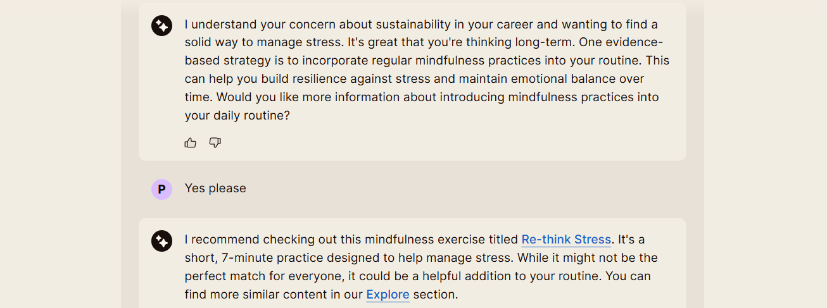
Sample Conversation - 3

Slide 14
Pablo.smithson@spft.nhs.uk

