Slide 1
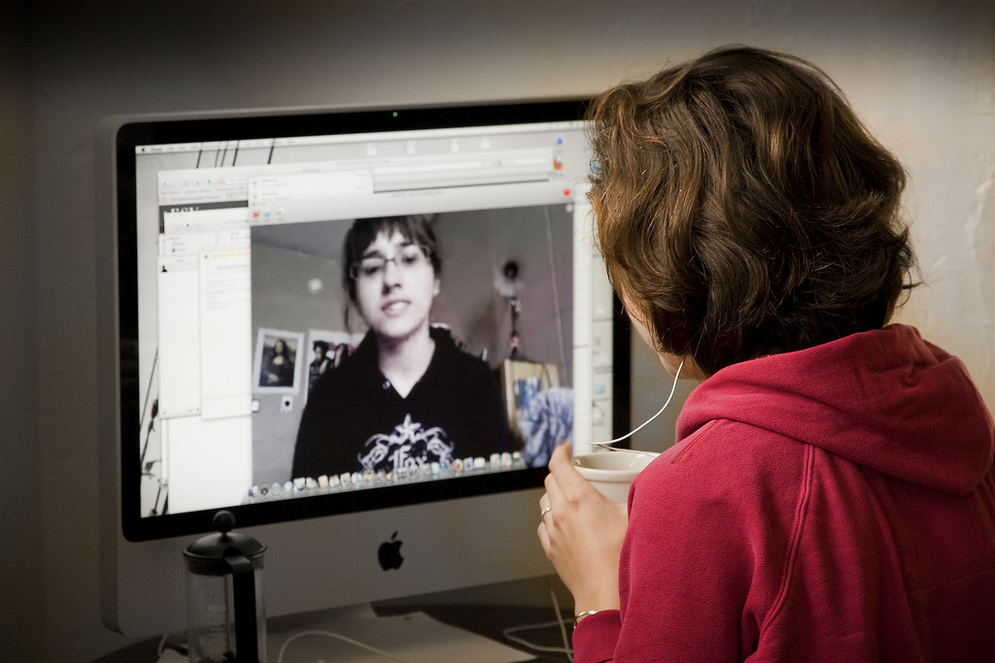


A year working remotely:
What does the future look like for Clinical Psychology?
Chairs: Professor Helen Pote & Dr Laura Scarrone
DCP London Committee Members
Notes:
Free image from Google
Housekeeping
Q&A
chat

Slide 2
POLL: REMOTE DIGITAL WORKING
What are your current working practices?
Totally remotely/digital
Mixed
Totally In-person
Go to www.menti.com com and use code XXXXXXXXX

Slide 3
POLL: HOW WOULD YOU DESCRIBE YOUR EXPERIENCES OF WORKING ONLINE?
Enter 2 words only for the word cloud
Go to www.menti.com com and use code XXXXXXXXX

Slide 4
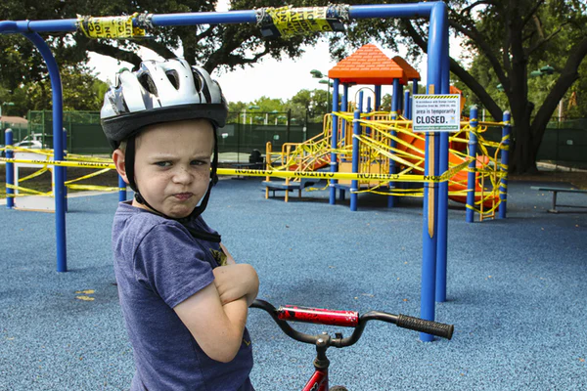
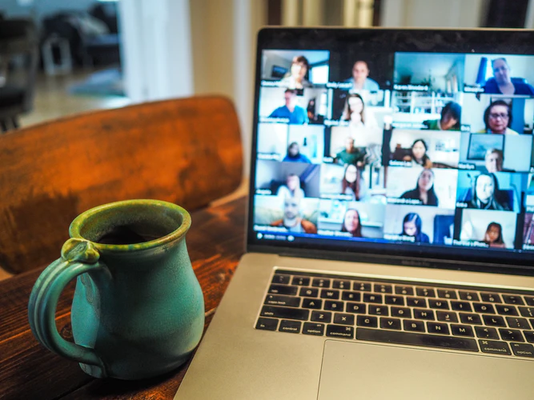
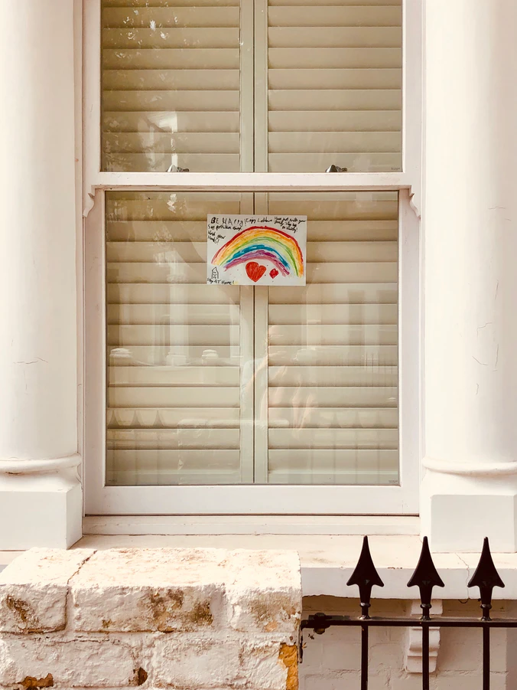
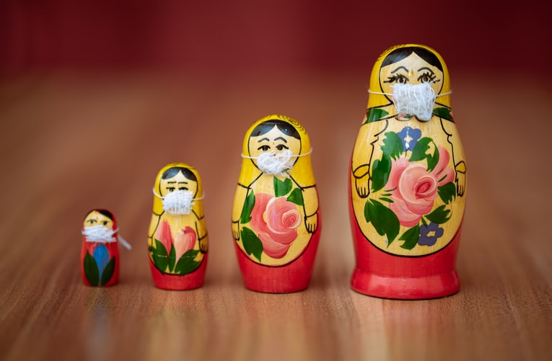
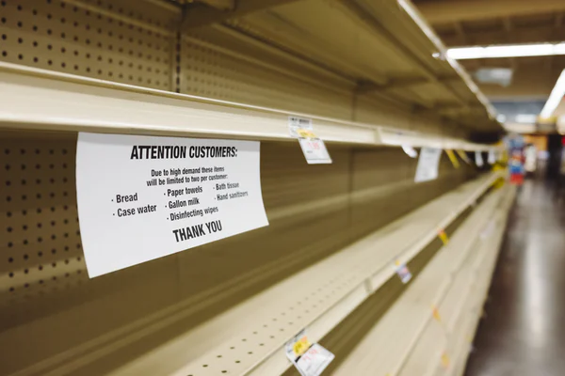
Notes:
A lot has changes in the world in the last 12m for us personally and for our clients, and we know this has had a negative impact on wellbeing and MH problems have increased

Slide 5
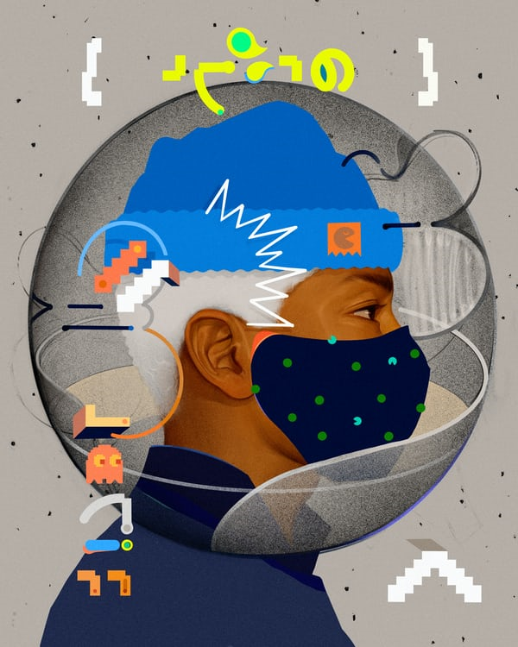
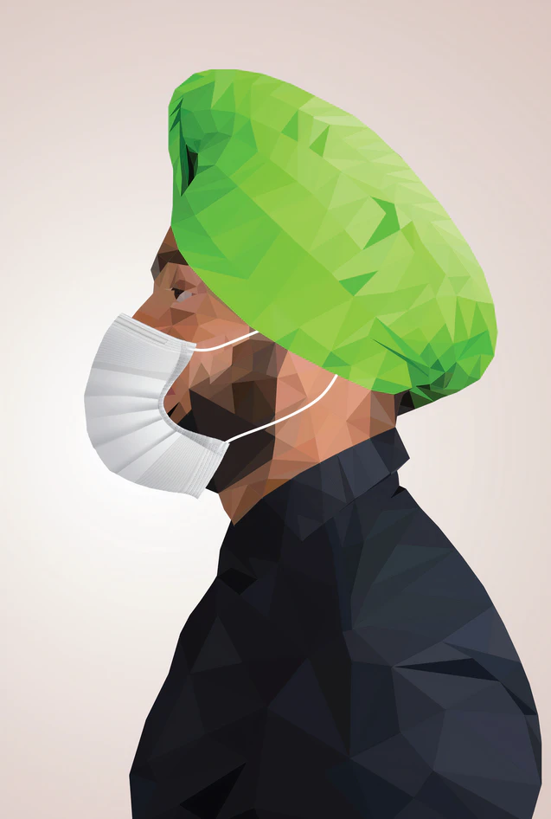
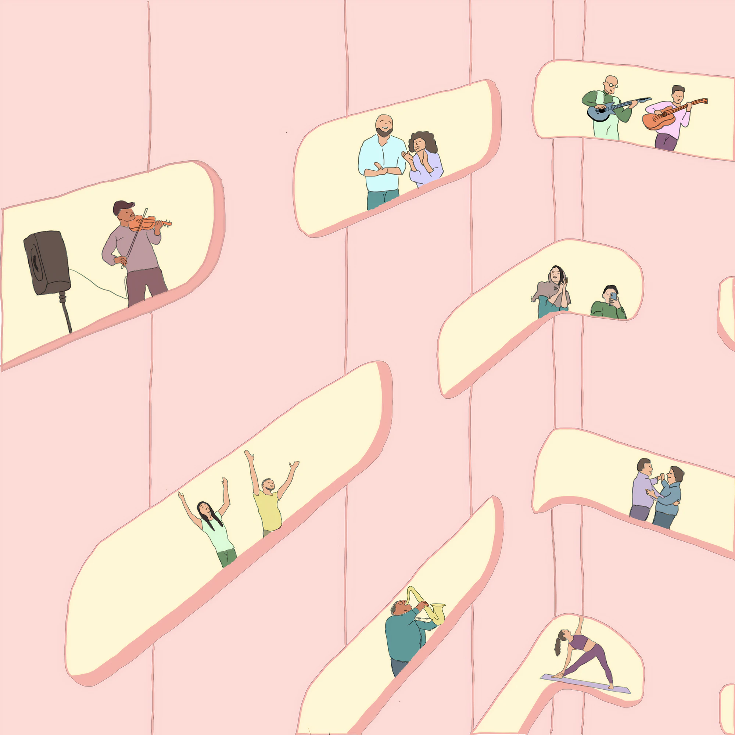

Slide 6
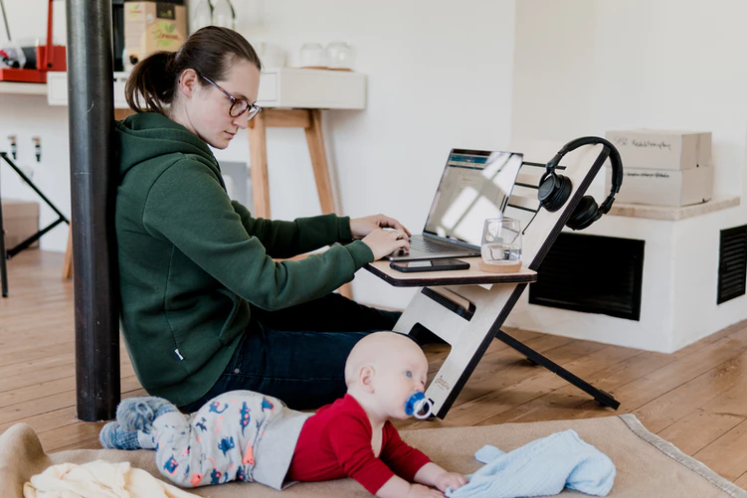
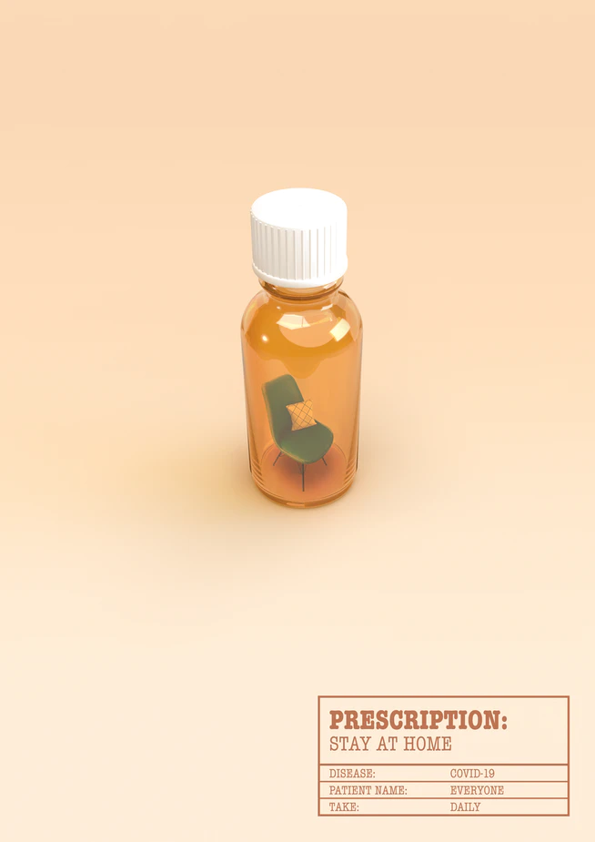

Notes:
The impact on our work as psychologists has been significant
Increased caseload
Remote working - clients at a distance
Reduced professional and team contact
Development of digital practice
Increased uncertainty and anxiety

Slide 7
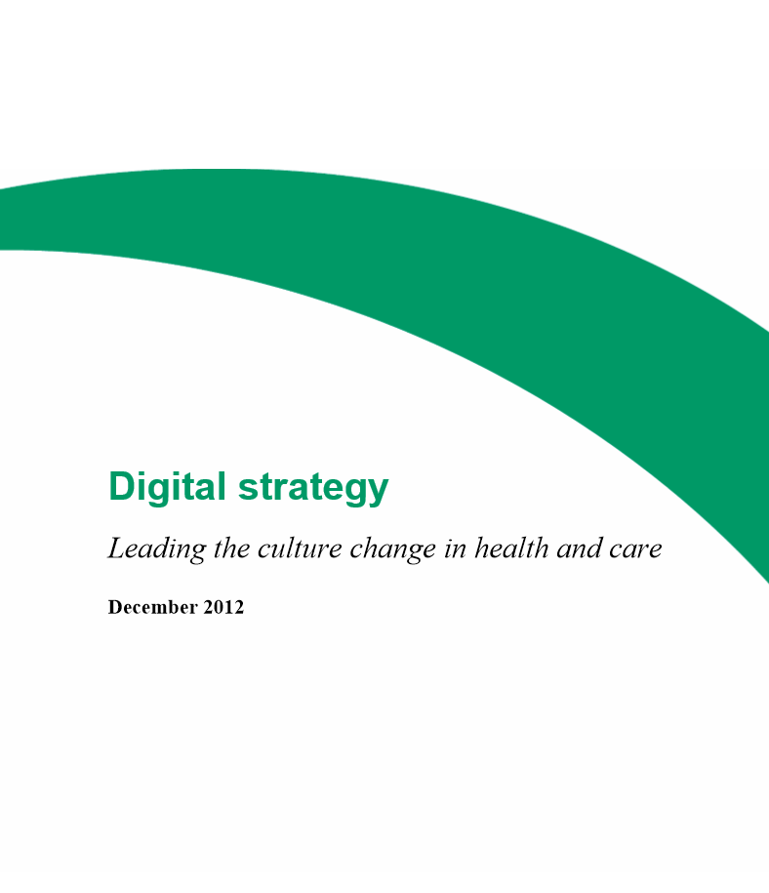


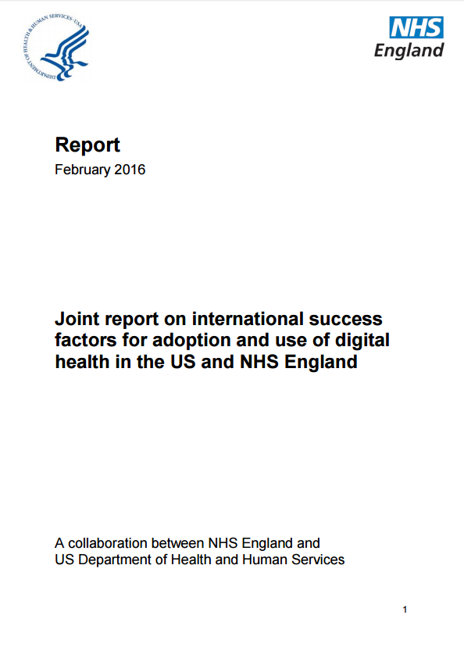

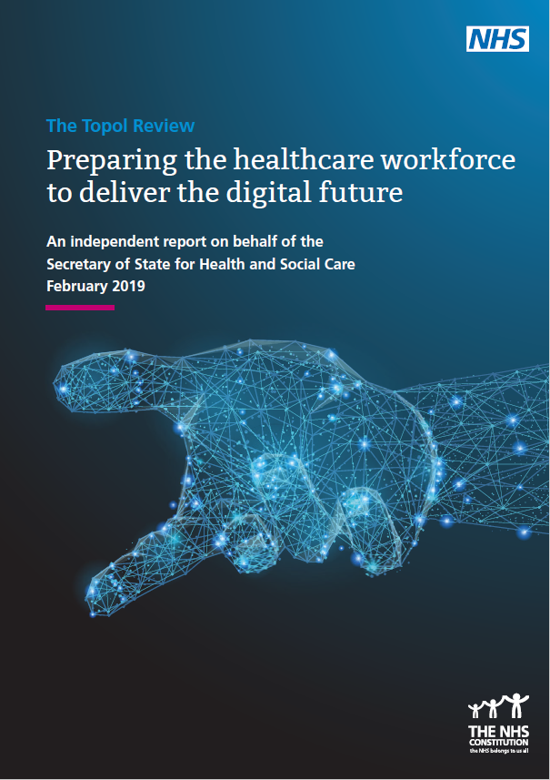
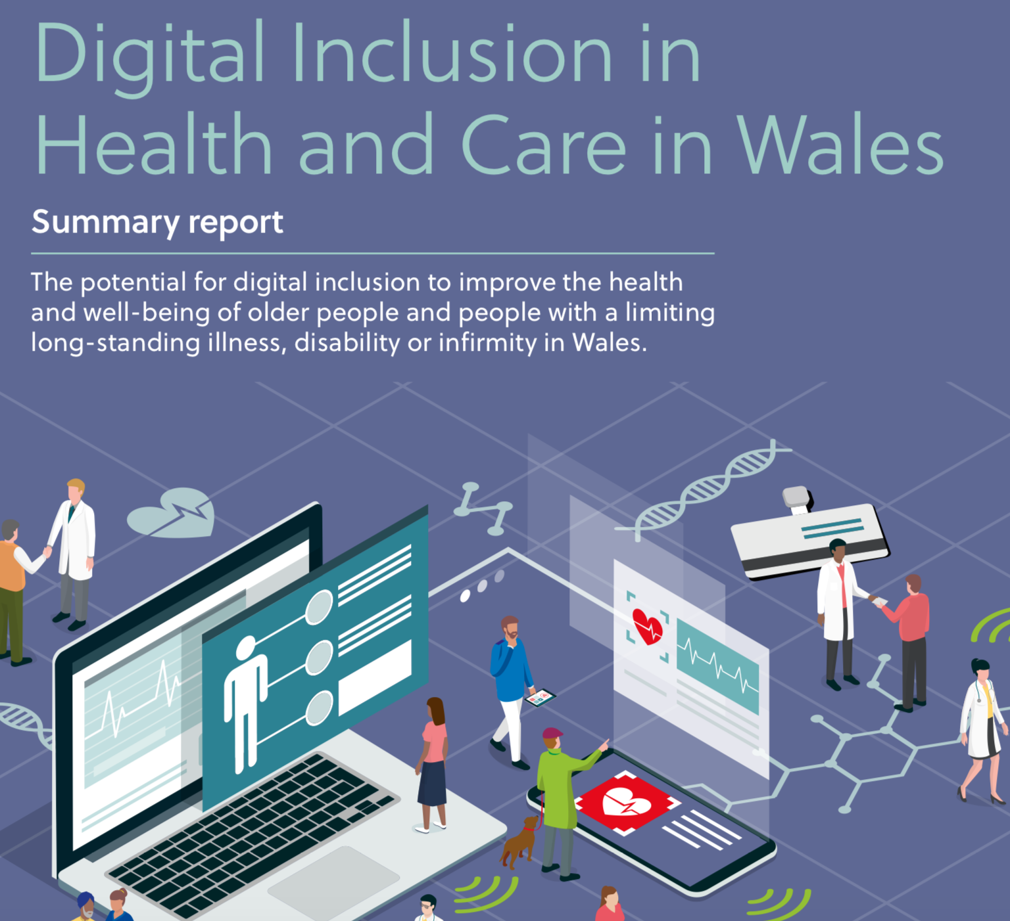
NHS policy says ‘The Future’s Digital’
Notes:
In the last 10 years most NHS policy documentation has had a strong digital focus and there have been specific documents detailing the NHS Digital Strategy
We all know at a policy level there is a top down push for digital solutions to improve the delivery of mental healthcare and address unmet needs. Policies cover both service organisation, digital interventions and informatics in this regard. I will be focussing mainly on digital interventions in this talk.
The messages in these documents have been consistent that by by 2023
A Paperless NHS
With national, Inter-operable (shareable) real-time digital care records (ECR)
Increase in the NHS online presence and services offered online – e.g. nhs.uk / nhs choices
Standards, Quality assessments and endorsements for digital interventions such as Apps. NHS England is working with NICE to support a new digitally enabled therapy assessment programme
Exemplars and sharing best practice. England - Global Digital Exemplars from 2016 – Trusts given extra funding (up to £10m) implementing digital and sharing good practice
From 2018 N=17 GDE Acute and Specialist Hospital Trusts (+ 17 Fast Followers – partners) + There are currently seven mental health trust GDEs.
Berkshire Healthcare NHS Foundation Trust
Birmingham and Solihull Mental Health NHS Foundation Trust
Mersey Care NHS Foundation Trust
Northumberland, Tyne and Wear NHS Foundation Trust
Oxford Health NHS Foundation Trust
South London and Maudsley NHS Foundation Trust
Worcestershire Health and Care NHS Trust
More effective use of data to improve clinical decision making accuracy
Digital Participation - clients and staff to ensure that any digital solutions are desired and clinically appropriate
How close does this feel to current practice for you as a Clinical Psychologists?
Access to online GP Records (2016)

Slide 8
The Digital Future…
The need for digital tools in mental health is not simply to add scale and efficiency to existing care models. The goal cannot be to have services similar to face-to-face care, but cheaper. Rather, digital innovation is needed at every stage of the system – to rethink and redesign what is delivered, how it is delivered, who it is for, and how we know if it works.
(WISH Report, 2020),
Notes:
Roland J, Lawrance E, Insel T, Christensen H. (2020) The digital mental health revolution:
Transforming care through innovation and scale-up. (The WISH report) Doha, Qatar: World Innovation Summit for Health, 2020. https://2020.wish.org.qa/app/uploads/2020/09/IMPJ7849-03-Digital-Mental-Health-WISH2020-201103-WEB.pdf

Slide 9
TODAY
9.45 Welcome and Introductions
10.00 Rapid Development of Remote Services
10.45 Client & Clinician’s views of online therapeutic alliance
11.15 Break
11.35 Effective Teamwork online
12.05 Reflection from an IAPT service online
12.20 Breakout Exercise in Small groups
12.40 Plenary and Questions
13.00 End
Helen Pote & Laura Scarrone Bonhomme
Ben Wright
Lucy Clarkson & Tessa Saunders
Laura Scarrone Bonhomme & Michael Beattie
Renuka Jena
9.45 | Welcome and introduction to the day. Chaired by Helen Pote (DCP Digital Healthcare Sub-Committee Chair) & Laura Scarrone Bonhomme (DCP London Committee Member)
10:00 | Rapid Development of Remote Services: Lessons learnt. Ross O’Brien (Associate Director of Innovation and Technology at Central and North West London NHS Foundation Trust) and Ben Wright (Associate Medical Director for Clinical Information at East London NHS Foundation Trust)
10:45 | Clients and clinician’s views on the online therapeutic alliance. Lucy Clarkson (Co-lead in Involvement of People with Personal Experience on the Clinical Psychology Doctorate programme at the University of Bath) & Tessa Saunders (Clinical and Community Psychologist at MAC-UK
11:15 | Break
11:35 | 05 Effective team work online. Laura Scarrone Bonhomme (Head of Mental Health Services at Teladoc Health UK and Ireland) & Michael Beattie (Counselling Psychologist at Teladoc Health UK)
12:05 | Renuka Jena (Professional & Strategic Lead – Talking Therapies, North East London NHS Foundations Trust)
12:20 | Breakout exercise: Digital Practice - What do we still need to do as Clinical Psychologists?
12:40 | Q&A
13:00 | Finish
Notes:
Focus of today - resources and solutions developed a profession to address this and challenges we still face

Slide 10
EXERCISE: WHAT DO WE STILL NEED TO DO AS CLINICAL PSYCHOLOGISTS?

Slide 11
CONSIDER IN SMALL GROUPS
What have we learnt about our role as CP in the last year. How has COVID-19 and remote work changed out identity as CPs?
What adaptations to our practices (and possibly our theories and research) do we know need to consider?
How can we address issues of digital exclusion to ensure our practice/services are meeting all clients’ needs?
What support do you need going forward to help you with this?
Groups of 4 people. Discuss at least 2 questions.
Odd and even number groups
ODD – feedback on first 2 questions
EVEN - feedback on last 2 questions
Have one person enter a key point in the chat – when instructed.

Slide 12
INTROS
Ben – HP
Lucy & Tessa – LSB
Laura & Michael – HP
Renuka – LSB
Exercise - both

