Slide 1

Working remotely in a gambling service: Challenges and opportunities
Dr Rachel Barcroft
Clinical Psychologist
NHS Northern Gambling Service
Rachel.barcroft@nhs.net

Slide 2
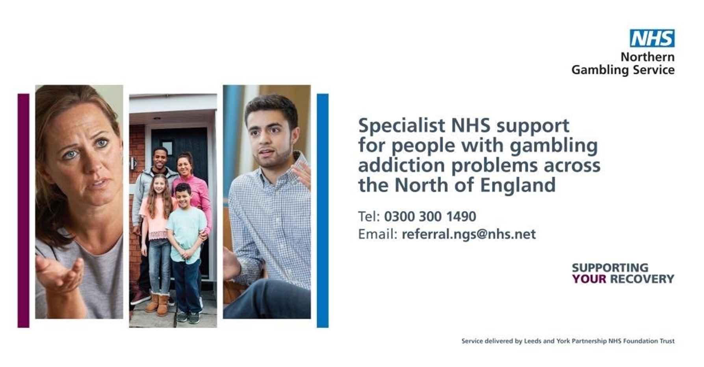

Slide 3
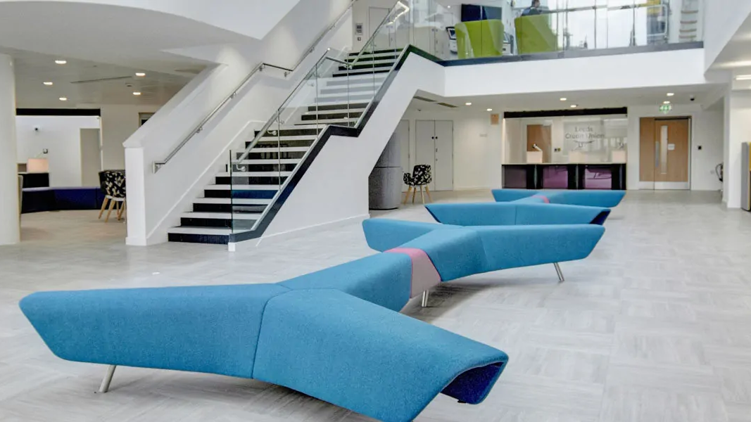
Who are we?
The NHS Northern Gambling Service provides specialist addiction therapy to people affected by gambling addiction, as well as those with mental health problems such as depression, anxiety, trauma, and suicidal feelings. We also provide help to people close to those with gambling addiction, such as family, partners, and carers.
We have bases all over the North of England including Leeds, Manchester, Sheffield, Newcastle, Preston and Liverpool.

Slide 4
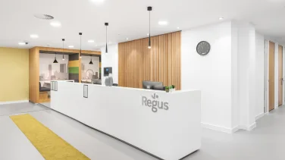
Background
We cover a large geographical footprint (all of North of England)
We offer CBT for gambling addiction
Service opened Leeds clinic in 2019, then Salford and Sunderland in early 2020
Initially offered face-to-face or telephone appointments
Pandemic in 2020 led to whole team working from home
Had to think creatively about how to continue to reach service users

Slide 5
Reaching service users during the pandemic
Were able to use a variety of video communications to reach service users e.g. Zoom, WhatsApp
Remote shared inbox was developed so that staff could email service users
Shared inbox monitored by admin team
Groups moved to online format to allow for continuous delivery of group CBT model

Slide 6
Working remotely- current service model
Hybrid model of working for all staff (at least two days in the office per week, as well as working from home)
Referrals processed electronically
Groups delivered online
Assessments and individual therapy sessions can be conducted remotely or face-to-face
Data collected and disseminated electronically

Slide 7
Remote model – referral process
Much of back-office admin from referral to initial assessment conducted electronically using email and Smart Surveys
Referral forms completed electronically
Extra pre-assessment data collected by Smart Survey
Appointments booked and reminders sent by email

Slide 8
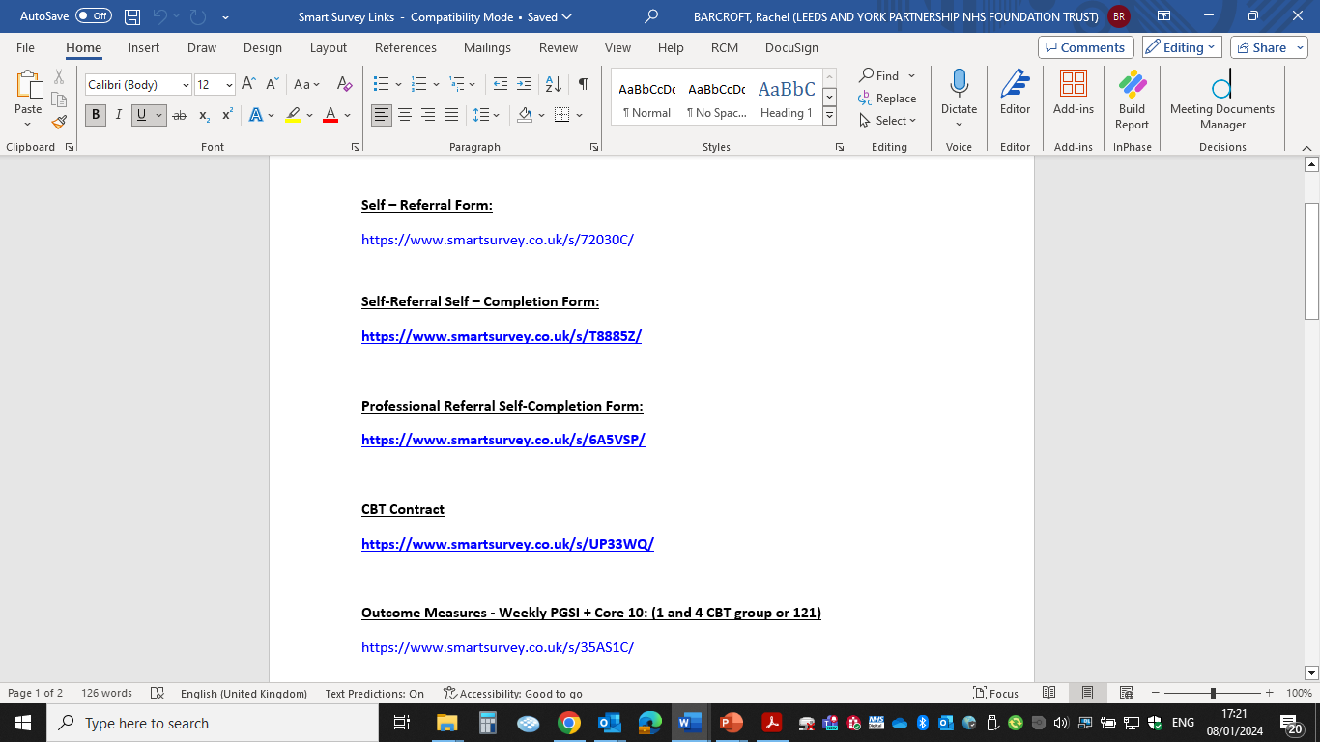

Slide 9
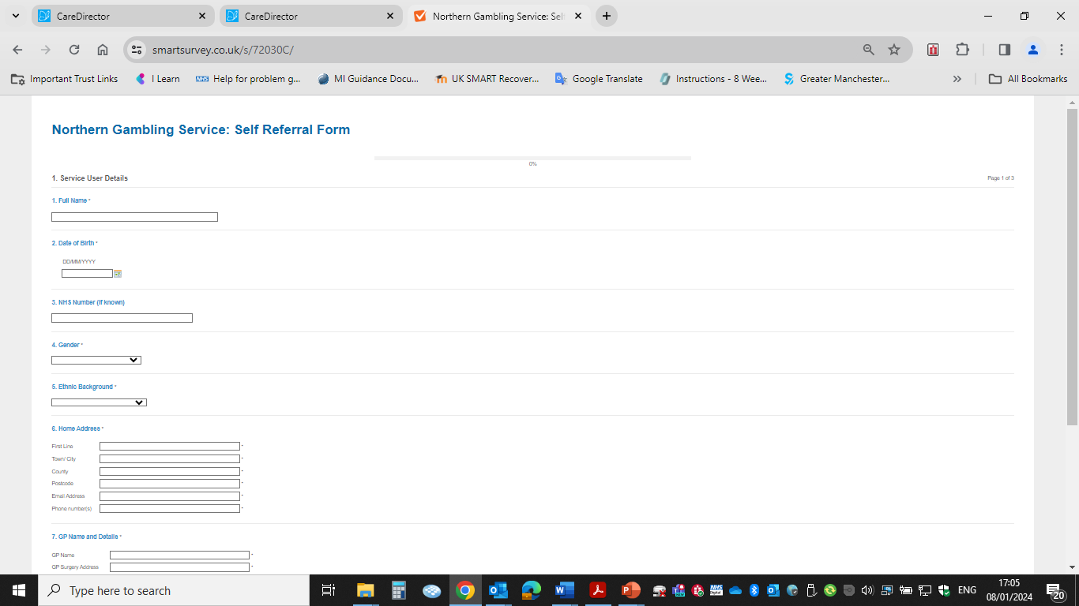

Slide 10
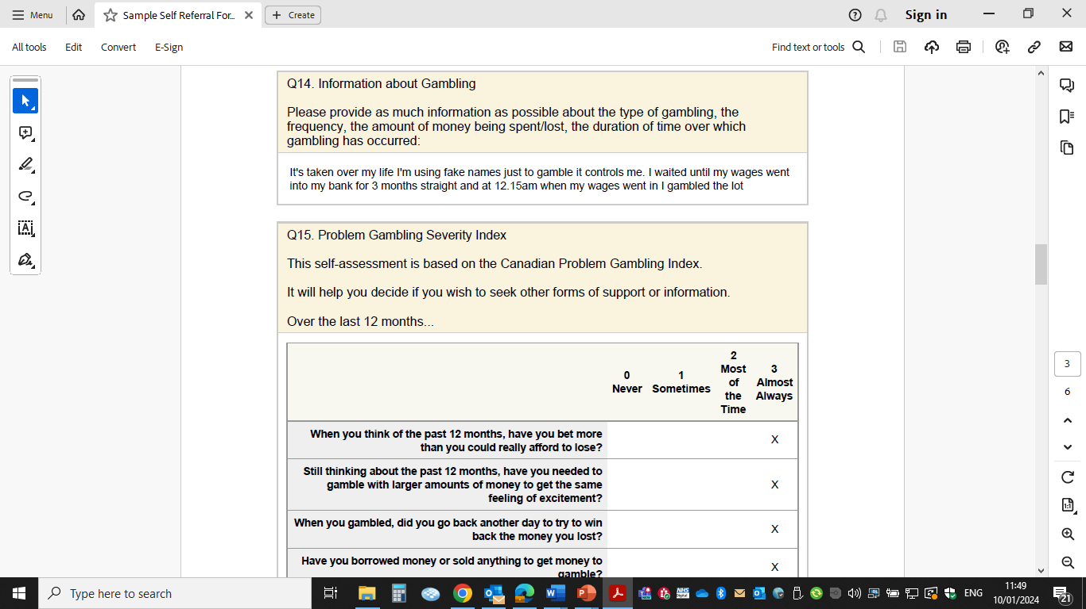

Slide 11
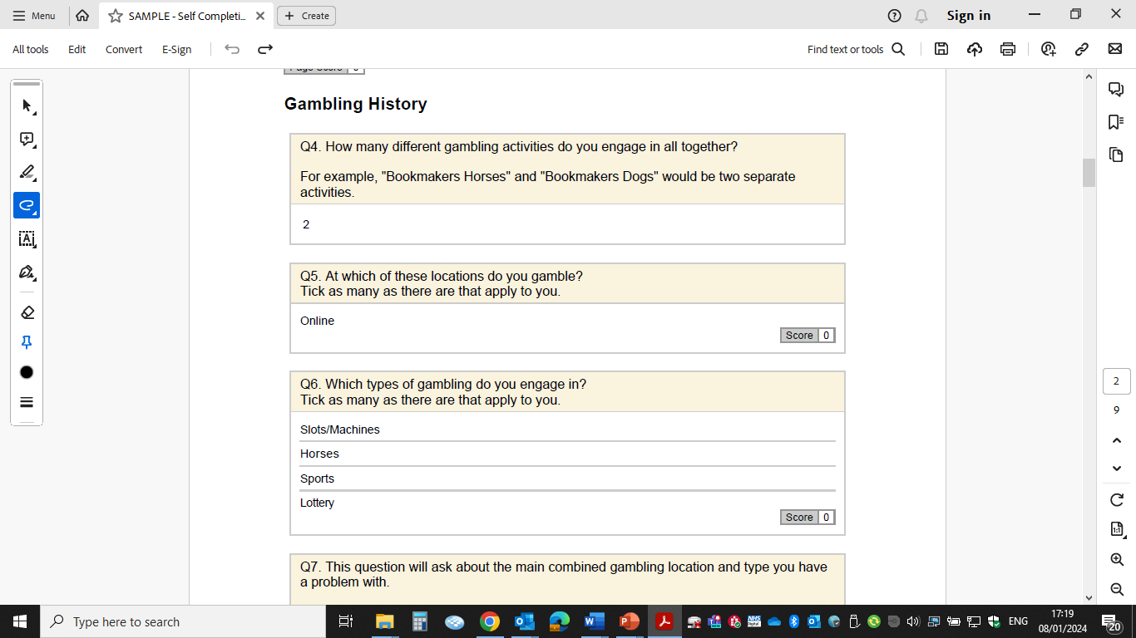

Slide 12
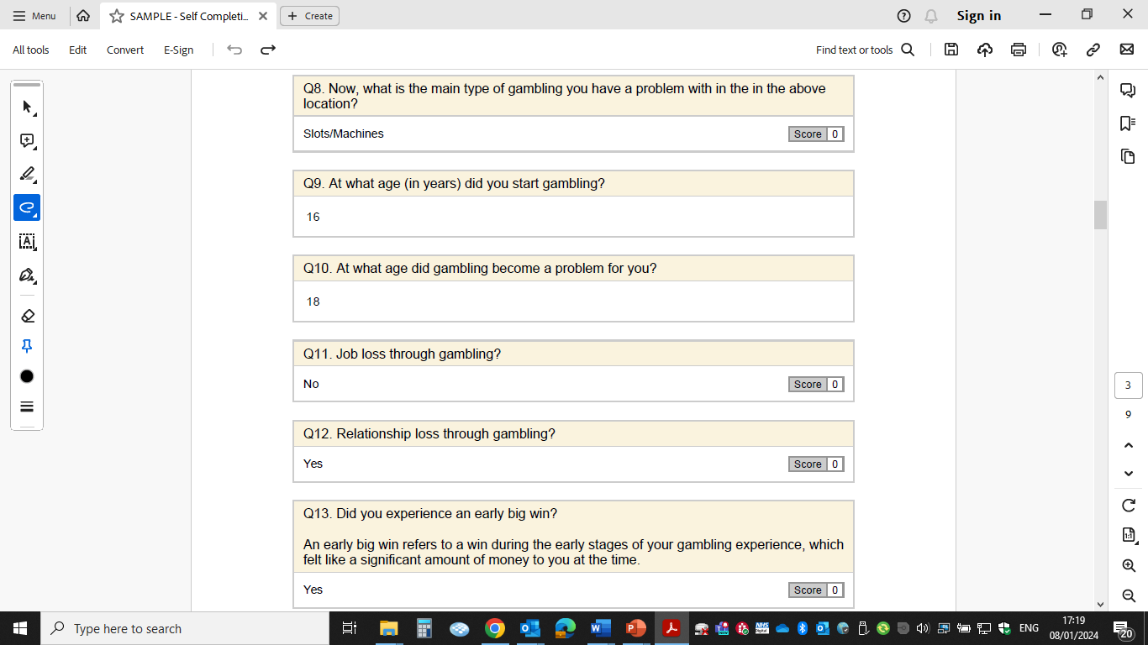

Slide 13
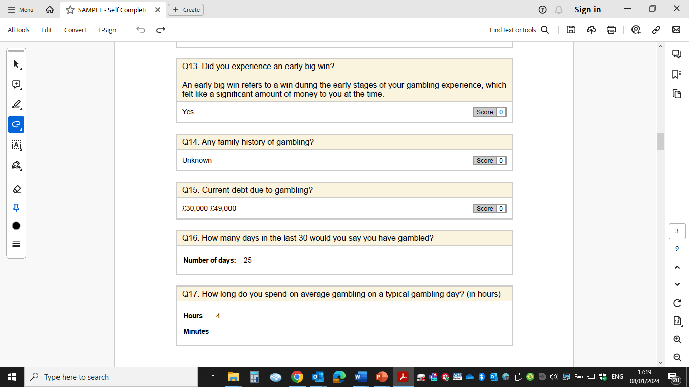

Slide 14
Benefits
Allows referrals to be processed quicker and assessments to be offered faster than relying on post and telephone
Triage can be conducted online
Allows data collection pre-assessment, saving time in assessment to focus on assessment and formulation of gambling behaviour
Service users can respond to emails when convenient
Some service users prefer email contact as more confidential than receiving letters in post
Client group tend to be tech savvy and like the option of email communication

Slide 15
Challenges
Some service users have issues accessing / using emails, internet
Service users can miss emails sent (junk mail, not checking emails)
Difficult to know if service user has received email if no reponse

Slide 16
Solutions
Service users are made aware at time of referral that email is the preferred communication of the service when they are referred into service, so they know to expect emails and check accounts accordingly
Service users can make service aware of any barriers to using this form of communication
Admin team/ peer mentor can contact to collect referral information over the phone
We accept paper referrals if electronic methods not easy for service users
Use shared remote inbox used by all practitioners to reduce direct email contact to clinicians (need to make service users aware that emails can be read by other team members)
Mark emails as confidential to work in line with information governance requirements

Slide 17
Data collection
Benefit of relying heavily on digital communication methods is that we collect a large amount of data electronically
Allows us to easily compile progress reports that we send to users
Can use the data for research purposes and to shape still developing service
Service users can see that we are using the data that we collect from them
Information we collect pre-assessment (self-completion form) is presented in graphic form during MDT discussion

Slide 18
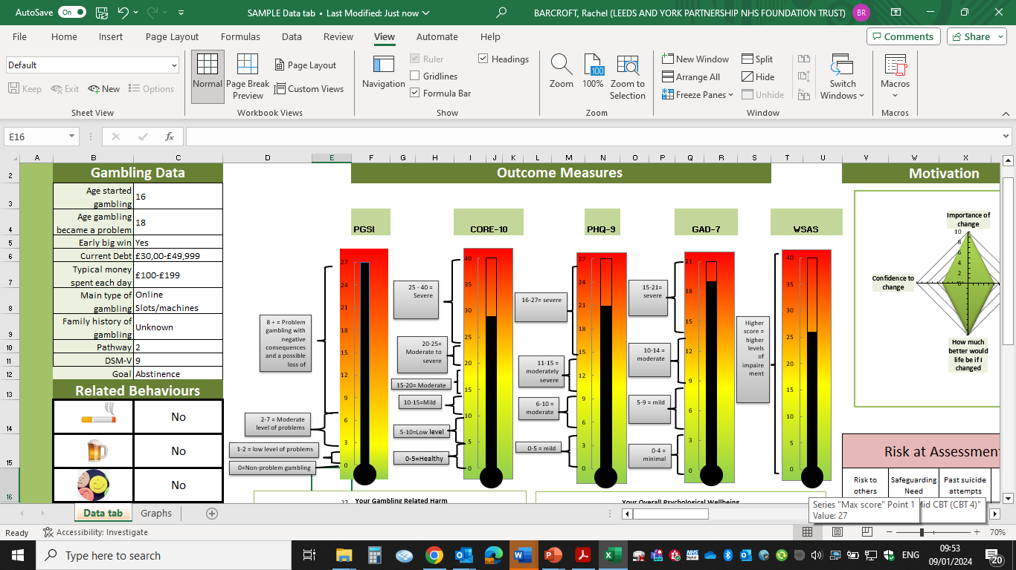

Slide 19
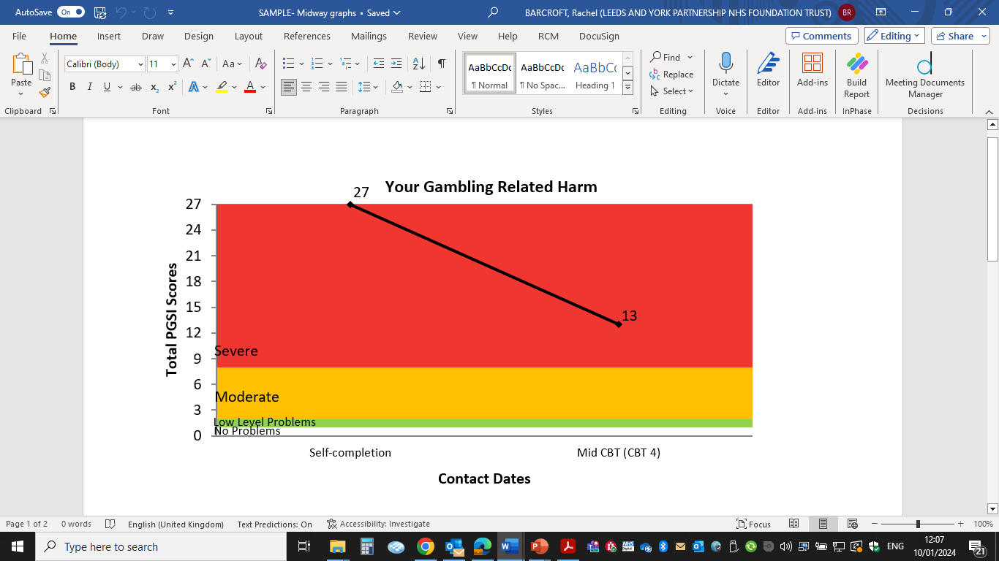

Slide 20
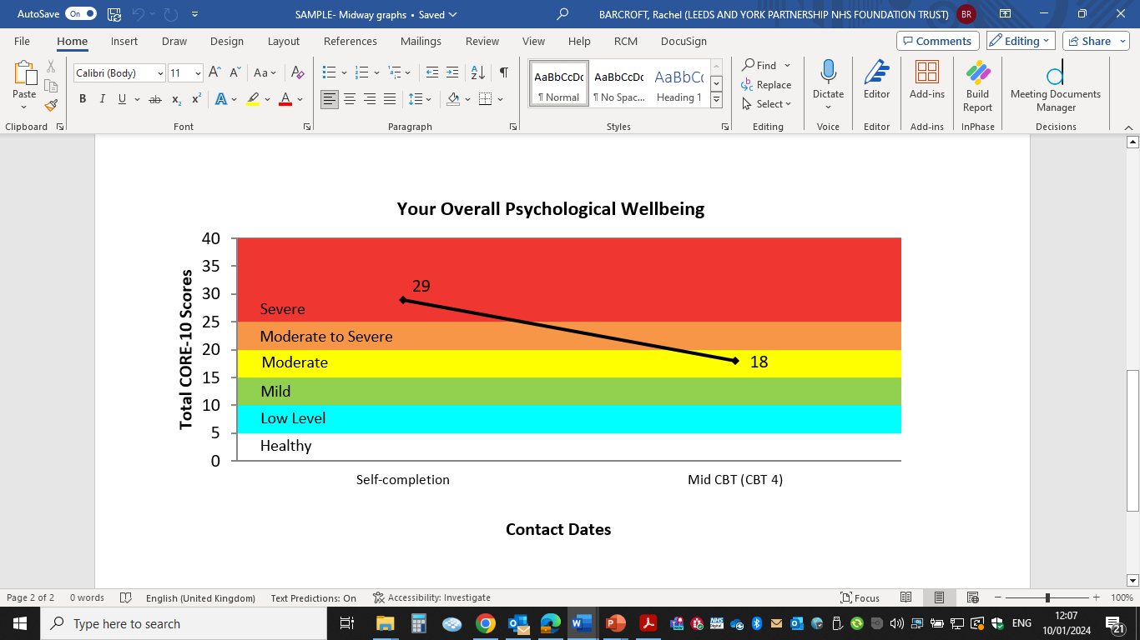

Slide 21
Delivering groups online - benefits
Greater flexibility of facilitators reduces geographical and logistical limitations
Run choice of groups online – allows people to access support for gambling addiction with minimal disruption to work and other responsibilities
Allows people with social anxiety to attend appointments
Reduces costs for service users and practitioners

Slide 22
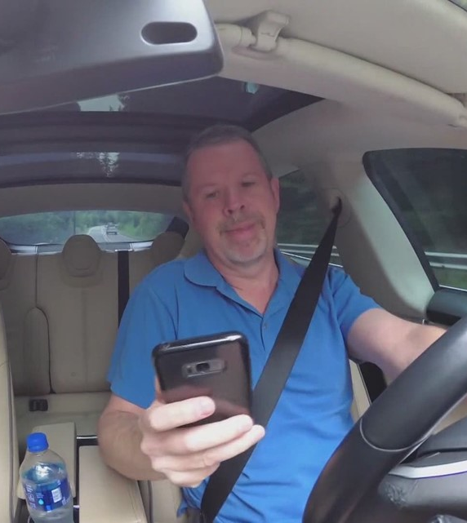
Delivering groups online - challenges
Service expectations versus respecting people’s living environments
People having cameras off during group
People attending in cars, while driving etc.

Slide 23
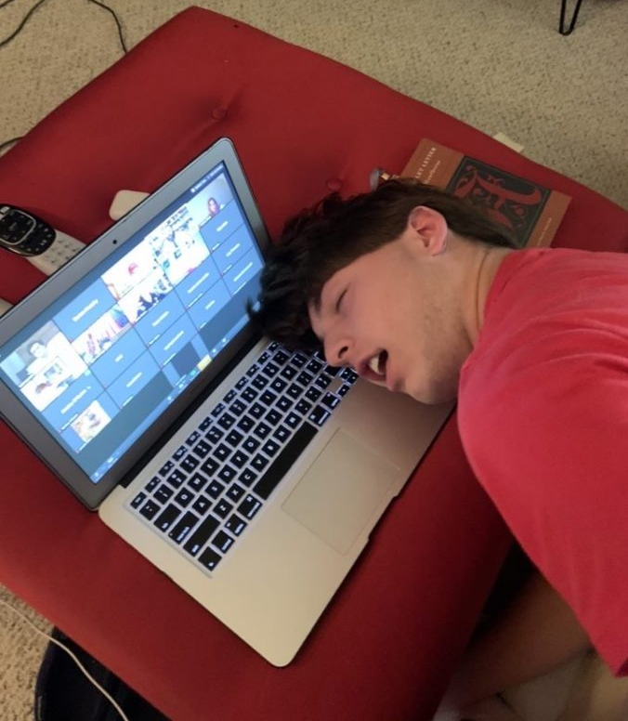
Delivering groups online - challenges
Have to be mindful that online meetings can be very unfamiliar for some people- need to clearly explain what they will be like so service users can give informed consent to attend
Can be difficult to maintain concentration for up to 90 mins

Slide 24
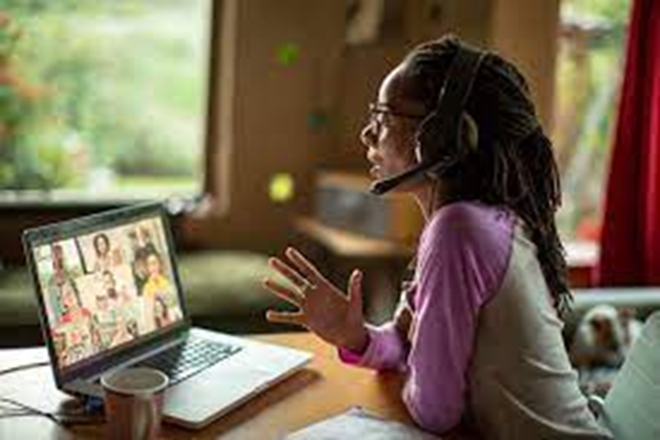
Delivering groups online - challenges
Some people do not like online format – may be more passive, lose concentration, feel anxious about using technology
Can be difficult to monitor people’s engagement when on screen, especially when screen sharing
Harder to develop peer relationships when online as less chance for informal contact before and after groups etc.

Slide 25

Delivering groups online - solutions
Service users sign electronic group agreement before group starts which outlines service expectations re attendance, confidentiality, general conduct on group
Cover ground rules at beginning of group
Short screen break during groups
Use breakout rooms to strengthen relationships and allow quieter participants to talk
Vary methods of content delivery to help maintain concentration levels
Do not allow people to join if driving, if other people in room etc.

Slide 26

Solutions
People who have issues with technology- offer telephone or face to face appointments.
Properly assess people’s readiness to attend group- issues with keeping cameras off etc.
Get peer support worker to help them get online etc.
Do test calls before
Send Zoom user guides to people
Use social network to support service users to join online groups, access video appointments etc.

Slide 27
Solutions
Emphasise the need to prioritise appointments and treat them in the same way as face-to-face healthcare appointments
If group format not suitable can be offered one to one appointments face-to-face or telephone
Co-facilitator monitors group members’ contributions, engagement levels etc.
Co-facilitator can call somebody if they leave group to check technology, risk etc.

Slide 28
Considering safety of service users accessing group
Do not let unknown names, devices into the meeting- broadcast to waiting room to change name to correct person
Chat function on Zoom- Do not allow private chats to take place between clients – participants can only direct message host of meeting
Make service users aware that service not able to deal with crisis and make them aware of appropriate agencies that can support them
Service users can use first name only on screen if concerned about anonymity

Slide 29
Delivering online therapy - benefits
Able to reach a large portion of population that would not be able to travel to clinic
Cost-effective for service and service users
Allows greater choice for appointments as more convenient for service users to accept online appointments at certain times of day than if they had to travel to a clinic
Reduces barriers for those who have mental health difficulties, health and mobility issues that may prevent them being able to attend face-to-face appointments

Slide 30
Considerations for online therapy
Use email to send over informational handouts, group content and worksheets
Not everybody has access to printers
Service users using smartphones rather than tablets or laptops can struggle to see information shared over screens (formatting/ screen sizes)
Solutions- send paper copies in post if needed – need to be organised to get paperwork to clients in timely fashion

Slide 31

Wellbeing of service users
Have to be mindful that people may be accessing emotionally difficult therapy from their own home
Encourage people to use a quiet room, preferably not their bedroom/ living room as may make difficult associations with emotionally driven therapy sessions
Debrief at end of session, bring them back to real world and contain difficult emotions / thoughts that may have arisen

Slide 32
Benefits of mixed model of working
Staff wellbeing – better work-life balance
Less commuting- reduced costs and time spent travelling
Allows for a sense of cohesion across a large area- staff based in smaller clinics still have access to full team through regular team meetings, group supervision sessions, MDT meetings all held online
Staff like the mix of face-to-face contact with colleagues and service users and remote working
Staff can come into office if they are struggling with working from home

Slide 33
Tips for hybrid working
15 minute breaks between clients
Take service users’ concentration levels into account.
Short breaks during sessions if necessary
Try to have mix of face-to-face / remote appointments in working day thus reducing screen fatigue
For smaller clinics, staff go into office on the same days to strengthen working relationships

Slide 34
Tips for hybrid working
Be boundaried with working hours when working from home- tempting to offer appointments out of working hours as laptop and mobile always to hand
Take screen breaks during service meetings
Service makes staff wellbeing a priority- have twice weekly wellbeing meetings in the morning and wellbeing check-ins during weekly MDT meetings to limit any isolation experienced from working alone

Slide 35
Working from home
Blur screens
Let people know you are at home but in a confidential space
Allow for disruptions e.g. somebody at door etc.

Slide 36
Summary
Staff appreciate the flexibility of a hybrid model of working and the considerations regarding their wellbeing in working in this way
Service users appreciate the choice of appointments offered
Collecting large amounts of data allows us to use this to contribute to research in the field

