Slide 1
Digital inclusion – from policy to practice
(or the top 4 things you need to know about Digital Mental Health)
Dr Ayesha Rahim
Feb 2024

Slide 2

Who am I?
Psychiatrist
Chief Medical Information Officer (SABP trust)
Clinical Lead for Digital Mental Health (NHSE)

Slide 3

Why is Digital Mental Health important?
How do we introduce the personal to the impersonal?
It’s already here!
Video consultations
Apps
SU access to notes
A computer will never be able to put its hand on your shoulder and tell you that everything is going to be ok [paraphrased]

Slide 4
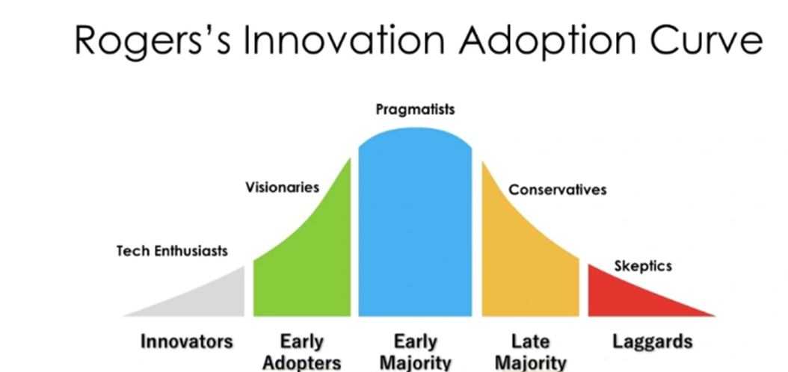
Why is Digital Mental Health important?
Notes:
Where are you on this curve? Where are your colleagues? Where are your team? Where is your organisation?

Slide 5
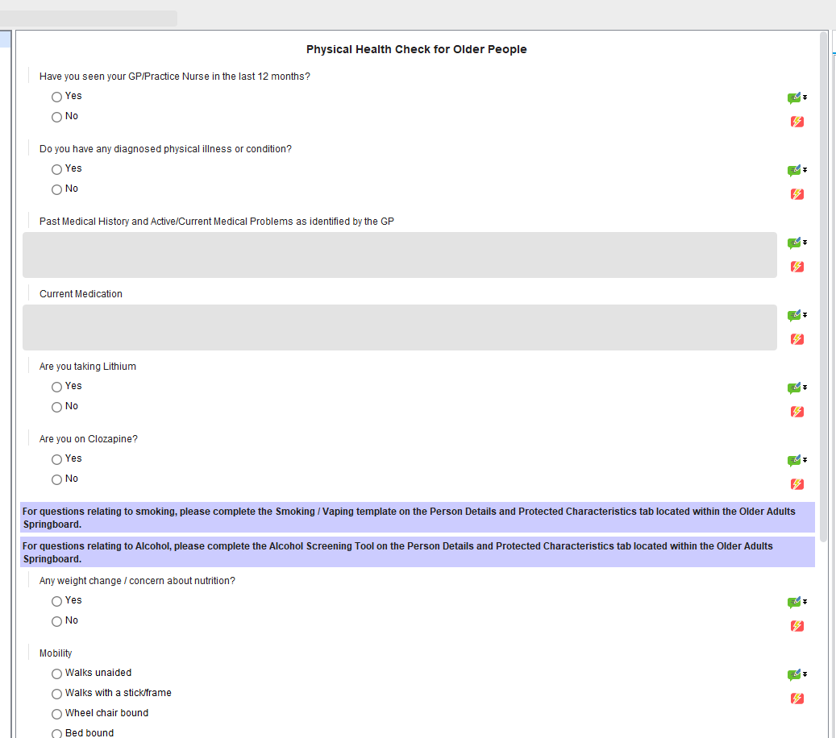
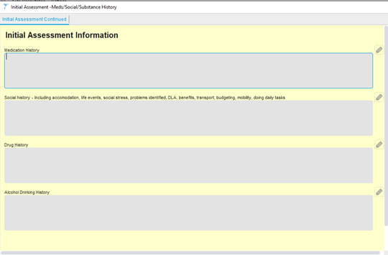
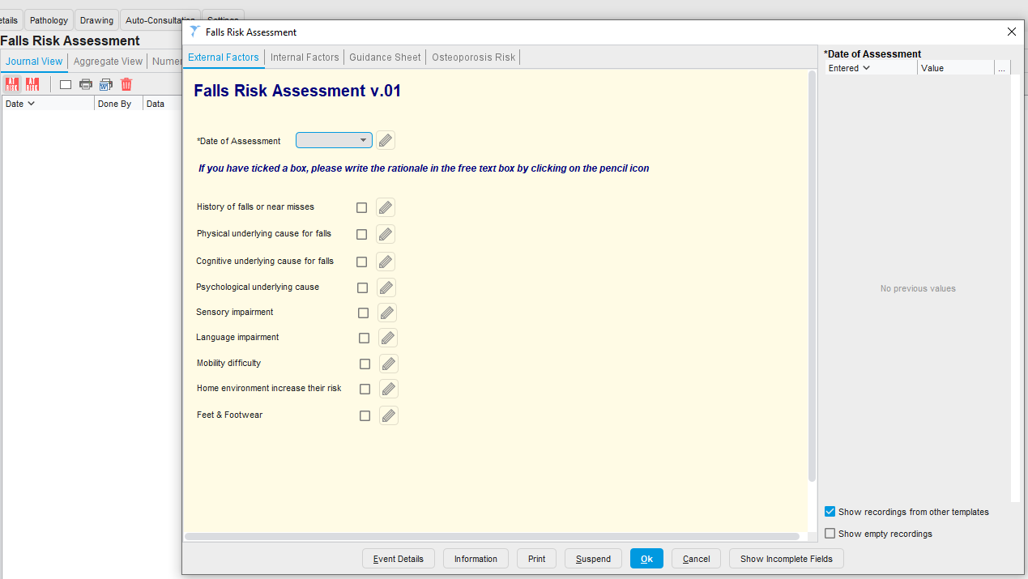
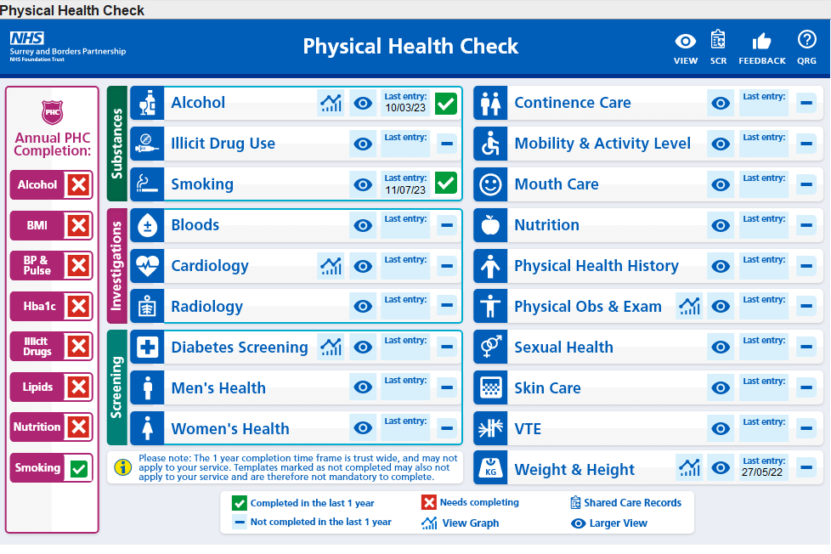
What’s happening nationally?
Big focus on Electronic Patient Records
They need to be better
Patient Engagement Platforms (PEPs)
Democratisation of health data
Early Value Assessment (EVA) process
How do we know what tech e.g. apps are safe and effective to recommend?

Slide 6
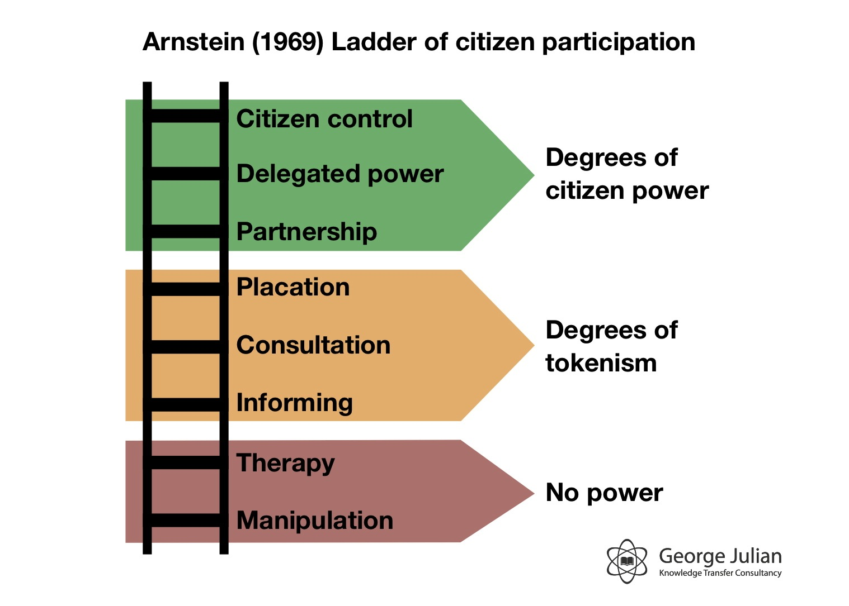
Digital Inclusion
Expand choice, not restrict choice
Psychologists as agents for change/advocates
Opportunity to reduce health inequalities

Slide 7

Digital Inclusion
The Well, Lytham St Annes – charity supporting people with addictions

Slide 8

Practical tips
Make contact with your organisation’s digital team e.g. CCIO – what’s on your trust roadmap?
Challenge transformation meetings you attend – how are you working with Experts by Experience?
Sign up to the NHS England Futures page and look at the resources
DMH priorities
Inclusive Digital Transformation in MH
https://future.nhs.uk/connect.ti/MHRH/view?objectId=28459216

Slide 9
The top 4 things you need to know…
Digital Mental Health isn’t coming – it’s already here
Psychologists could be the key to holding Mental Health to account for how we do this
Focusing on seldom heard voices is our chance to reduce inequalities, through digital
There are lots of like-minded colleagues passionate about this – seek them out!

