Slide 1




Digital Inclusive Practice Can Our Digital Psychological Services Achieve This?
This event will be recorded by attending you give consent

Slide 2


Welcome 3rd Annual Conference 12th January 2024
DCP Digital Health Care Committee
Our Mission:
Supporting competent and confident applied psychologists to deliver ethical digital practice.
Professor Helen Pote
Dr Alesia Moulton-Perkins
www.digitalhealthskills.com

Slide 3
What is Digital Health?
Our remit…
Working Definition of Digital Health Technologies
“Apps, programmes and software used in the health and care system. They may be standalone or combined with other products such as medical devices or diagnostic tests.”
NICE, 2019
Notes:
HP

Slide 4
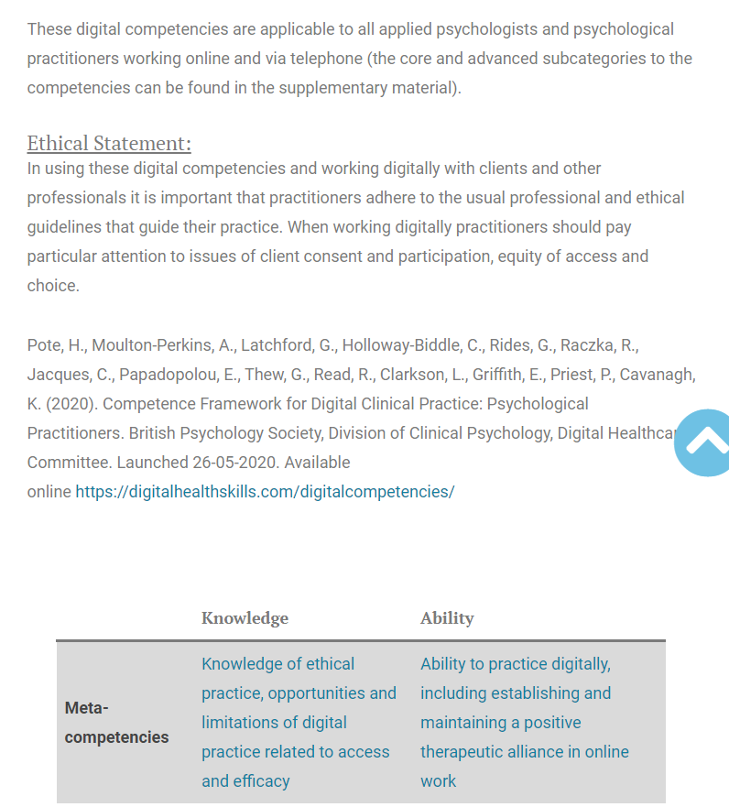
DCP Digital Healthcare Committee
www.digitalhealthskills.com
Digital Competences Framework for the Psychological Professions

Slide 5

DCP Digital Healthcare Committee
www.digitalhealthskills.com
Free Elearning
4 Modules

Slide 6
Aims of Conferences
Aim: Consider the equality and inclusivity of current and future digital psychological practice. Working together to overcome barriers to inclusivity.
Where are we at post COVID-19
Importance of thoughtful evidence-based digital practice
Importance of Training and CPD
Importance of Inclusivity

Slide 7
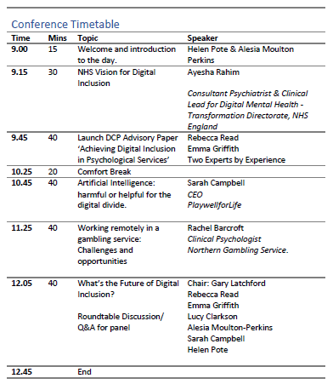
This event will be recorded, by attending you give consent for recording
Slides and recordings will be made available @ www.digitalhealthskills.com
Please mute yourself
We will take questions at the end of each presentation
Type your questions to the Q&A box
We will ask you to turn off your cameras for one presentation and roundtable discussion, to focus on speakers

Slide 8

What does Digital Inclusive Practice mean to you?
https://www.menti.com/alfi8dgzx93g
Use Code: 5355 3219
Type in your key words

